Slide 1


Twitter Sentiment Analysis
Amit Kumar Sahu
18MIS7250

Slide 2
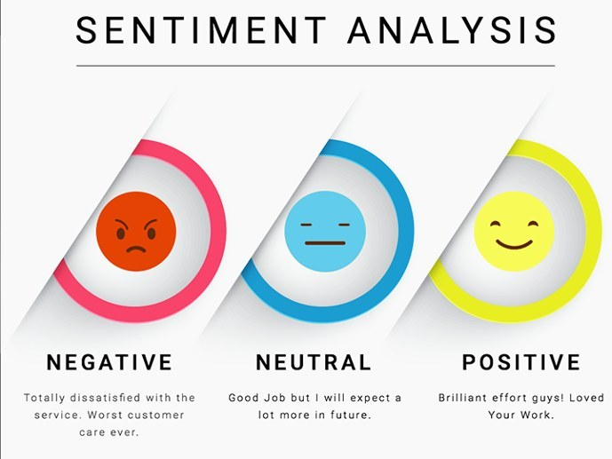
Introduction
The data gathered from customers’ responses like tweets, comments, feedback and any writing that’s related to products or services are studied and this process is called sentiment analysis.
Marketers and organizations are pursuing this process to stay relevant in the competitive field and to find a suitable way to advance their business.
As social media plays a significant role in almost every human’s life, most organizations are using it as the communication medium with their customers or other companies.
While companies use social media as a tool to interact with their customers, the comments and feedback derived from the customers are analyzed and used by companies as their guide to improving their products and service

Slide 3

Key Benefits of Sentiment Analysis
Improve Customer Service
Develop Quality Products
Discovering New Marketing Strategies
Improve Media Perceptions
Increasing Sales Revenue
Improve Crises Management

Slide 4
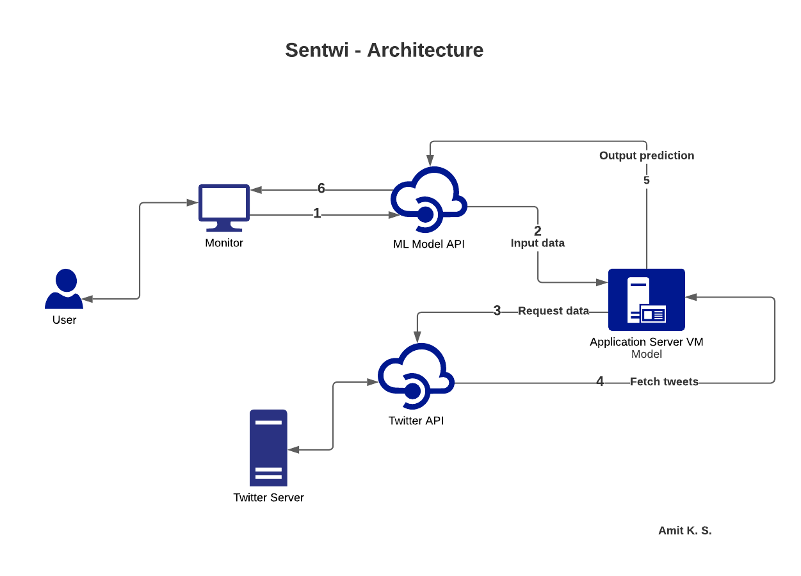

Slide 5
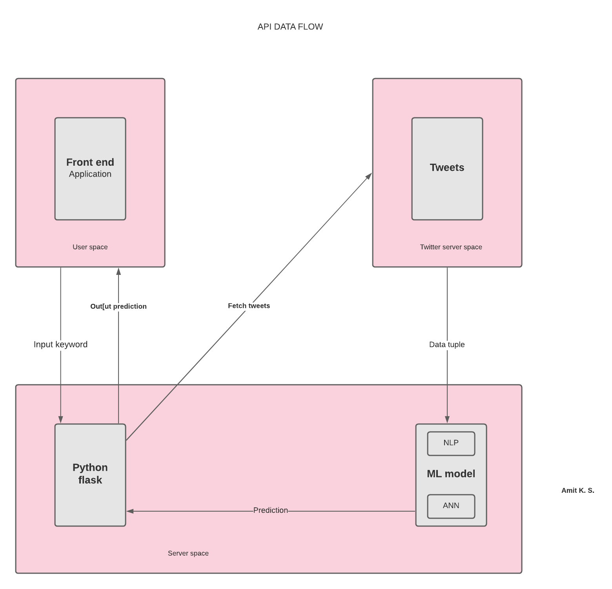

Slide 6
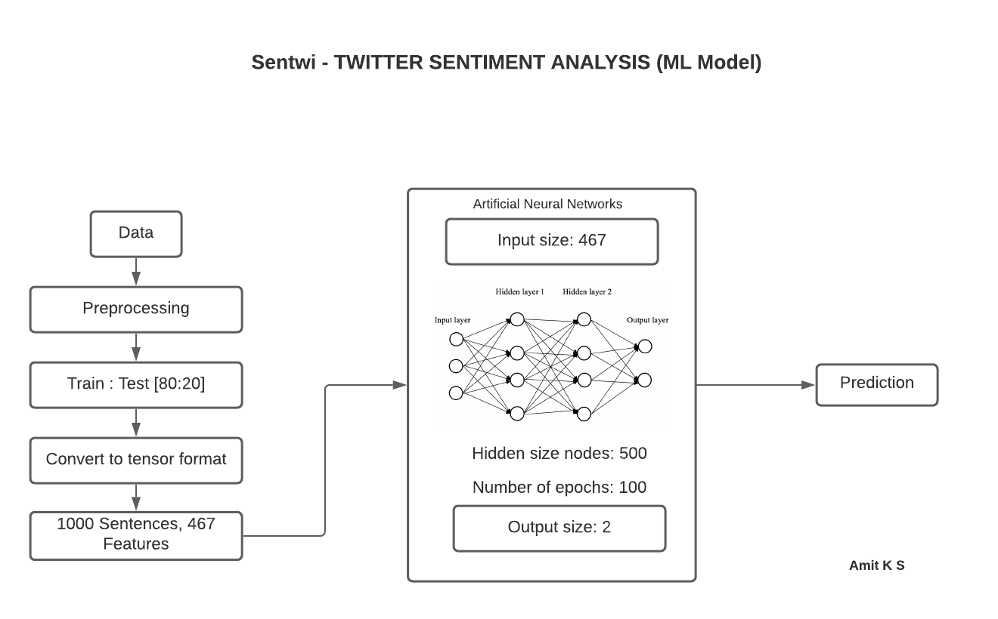

Slide 7
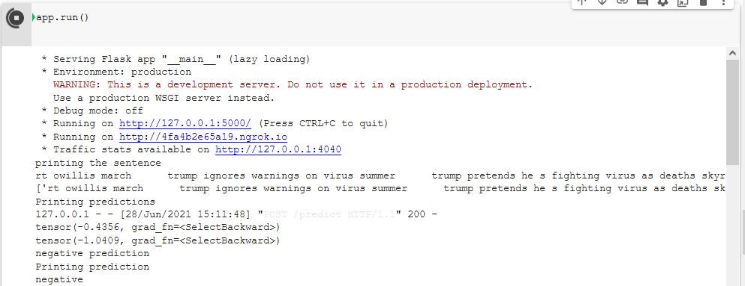
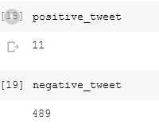
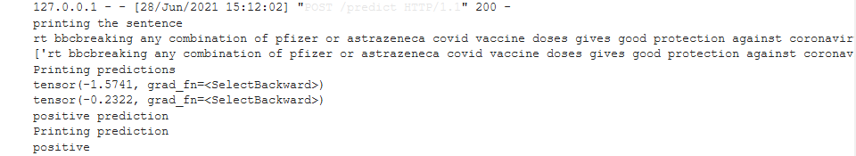
Output

Slide 8
References
https://www.commsights.com/benefits-of-sentiment-analysis-for-businesses/
https://www.kdnuggets.com/2018/03/5-things-sentiment-analysis-classification.html

Slide 9
Challenges faced while deployment
Whole application will take around 900MB in server. (no free server to deploy need to pay)
Around 1000 requests per minute (paid services)

